Slide 1
SWE 4538 Server Programming Final Project Presentation
Project Title: PizzaLagbe

Slide 2
Introduction
Name: K.M.Tahlil Mahfuz Faruk
Student ID: 200042158

Slide 3
Brief Overview of the Project
Develop a comprehensive online pizza shop website
User friendly interface for customers, administrators and delivery man
Enhancing overall pizza ordering and delivery experience

Slide 4
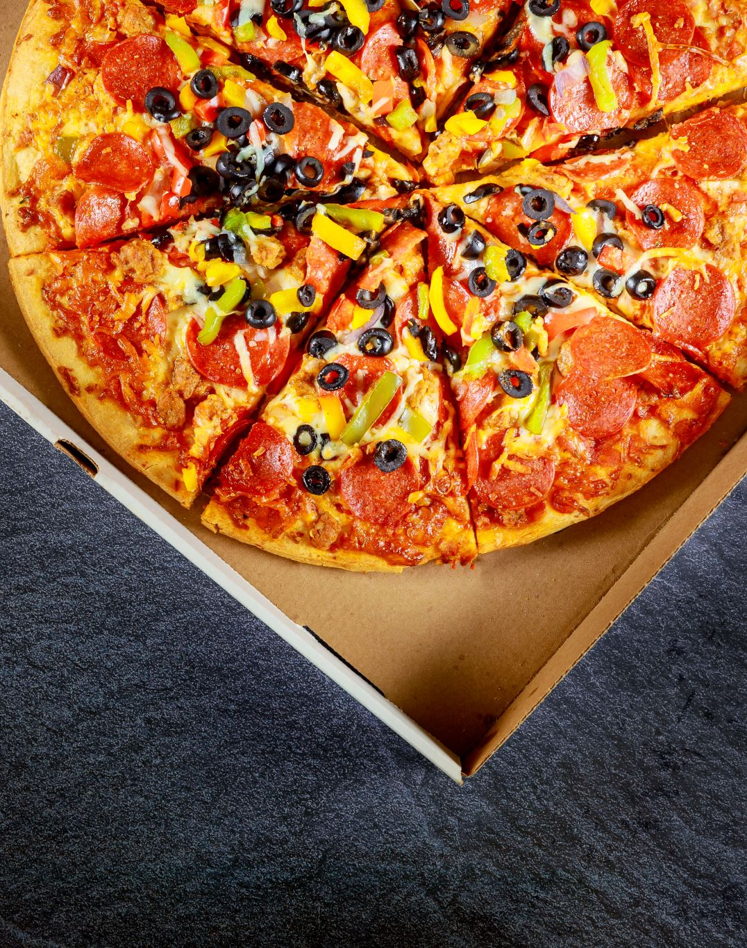
Key Features
Customer Panel
User login, signup
Login using Google OAuth2.0
Order Pizza
Order review
Upload profile image
Upload review through audio
Forgot Password

Slide 5

Key Features Continued….
Admin Panel
Admin login, signup
Add Delivery man
Add Pizzas
Add Toppings
Add Branch
Add Order Type
Show pending orders
Show Reviews
Update pizza processing Status

Slide 6

Key Features Continued….
Delivery Man Pane
Automatic Delivery Man assignment to orders
Delivery Man login
Delivery Man Change Password
Delivery Status Update

Slide 7




Technologies

Slide 8

Thank You Happy New Year

